Slide 1
Dental Radiography Systems
Course: BMED434 – Medical Imaging
Awab Abdallah 22700366
Date: 2/6/2025

Slide 2
Introduction
Importance of dental radiography in diagnostics
Types of systems: Intraoral, Panoramic, CBCT
Goal: Explore working principles, device structure, calibration, and safety

Slide 3

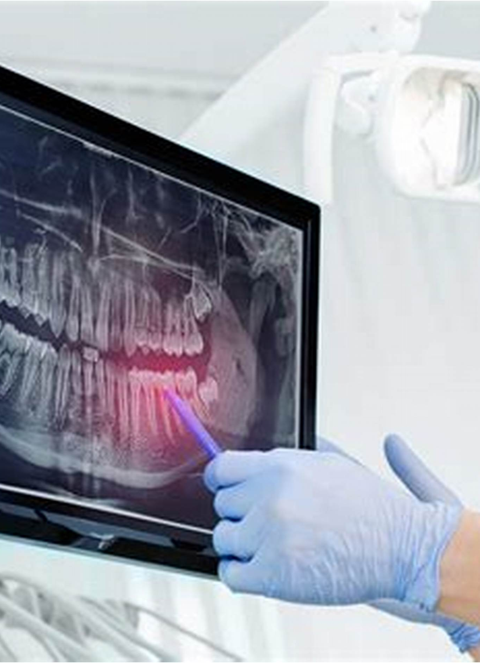
What Is Dental Radiography?
Imaging technique using X-rays to visualize teeth, jaw, and oral structures
Enables diagnosis of decay, infection, bone loss, and more
Non-invasive, fast, and widely used

Slide 4
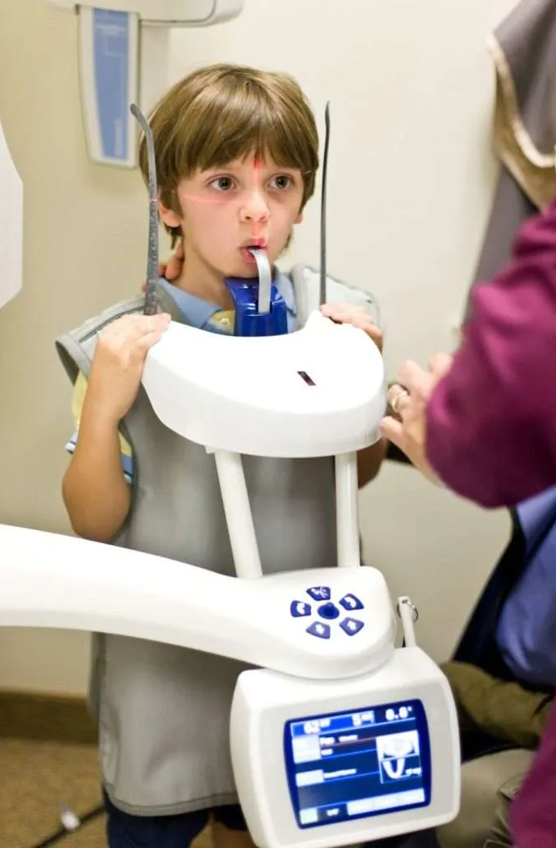




[ X-ray Machine ] ---> [ Mouth ] ---> [ Sensor/Film ] ↓ ↓ ↓ Sends X-rays Teeth & bones absorb Image formed X-rays → lighter → shows teeth, Soft tissue passes bones, cavities X-rays → darker

Slide 5
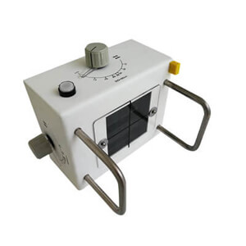
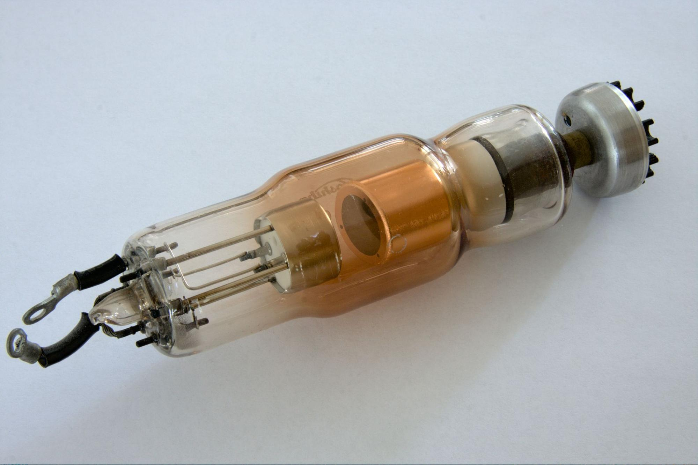

System Components The Tube Head An Extension Arm The Control Panel Image Receptor: Film, digital sensor Embedded Systems

Slide 6
Calibration Methods
Mechanical Calibration: Beam alignment, movement check
Electrical Calibration: kVp, mA, exposure time, dose

Slide 7
Electrical Circuits
"Dental X-ray machines have three main electrical circuits.
First, the high-voltage circuit controls the tube voltage, or kVp, which creates the X-rays.
Second, the low-voltage circuit heats the filament using mA, which controls how many X-rays are produced.
Lastly, the control circuits include timers, safety interlocks, and microcontrollers to make everything work safely and accurately.
The circuits also use components like transformers and rectifiers to manage power

Slide 8
Standards & Regulations
Dental X-ray systems must follow strict safety rules.
IEC 60601 ensures the equipment is safe.
IAEA and WHO give guidelines for radiation protection.
Each country, like the FDA or TAEK, handles licensing and inspections.
And for digital systems, DICOM and HL7 make sure images and data are handled properly."

Slide 9
Applications
Routine dental exams
Orthodontic planning
Implant and surgical guidance
Endodontic (root canal) evaluation

Slide 10
Conclusion
Dental radiography is vital to accurate diagnosis Safe,
reliable imaging depends on proper design and maintenance
Understanding system components and regulations ensures optimal performance
Continuous training and calibration are essential

